Slide 1
COMP9992
Yutong Zhang
Z5526932
Structural Interventions for
Intrinsic Interpretability
in Language Models
From positional encoding and structural sparsity to explicit concept interfaces
Notes:
Good morning. My project examines whether structural changes inside a Transformer can make its representations easier to understand, separate, and intervene on. I focused on four locations: positional encoding, sparse routing through Attention and the FFN, relevance-aware distance bias, and explicit concept slots projected from the FFN intermediate activation. The experiments did not all produce the result I initially expected, but together they narrowed the design space and identified one comparatively simple concept interface that is worth developing further.

Slide 2
Conceptual foundation
What does interpretability mean for a language model?
Interpretability is not merely visualising internal values. It means turning model computation into variables and relations that can be understood, validated, intervened on, and audited.
Observable
Understandable
Intervenable
Auditable
Information can be decoded, or a structural pattern can be observed
Features have stable identities, clear semantics, and reproducible descriptions
Targeted interventions produce the expected result with limited side effects
The method provides coverage, stability, and traceable records
Therefore, Attention visualisations, probe accuracy, or any single SAE metric provide only partial evidence.
COMP9992 · 02
Notes:
For interpretability, It is not enough to just draw an Attention map or attach a label to a neuron. I want an internal variable that can be read consistently, checked against the model's computation, changed in a controlled way, and audited by another researcher. This gives four practical requirements: the information must be observable, understandable, intervenable, and auditable. A probe score, an Attention heatmap, or a single SAE metric addresses only part of that problem.

Slide 3
Interpretability criteria (I)
First ask whether the representation is clear, stable, and compositional
Decodability and human understanding
A concept should not only be decodable by a probe; it should also have a stable semantic description that people can understand.
Evidence: concept AUPRC, automated descriptions, and human review
Monosemanticity and identity stability
A feature should have a concentrated semantic boundary and retain a recognisable identity across contexts, models, and seeds.
Evidence: hard negatives, cross-seed matching, and token-identity preservation
Hierarchy and compositionality
Lower-level concepts should compose into higher-level concepts, giving relations and intervention propagation a traceable structure.
This is an aspirational goal; the experiments do not yet implement explicit hierarchical aggregation
Being decodable is a starting point, not the endpoint: monosemanticity, stability, and composition determine whether an explanation is genuinely useful.
COMP9992 · 03
Notes:
The first set of criteria concerns the representation itself. Decodability asks whether a concept can be recovered. Human understanding asks whether the feature has a stable description. Monosemanticity and identity stability ask whether that description remains recognisable across contexts and random seeds. Hierarchy asks whether lower-level concepts can combine into higher-level ones through a traceable structure. These properties are related, but they are not interchangeable. A feature can be easy to decode and still be unstable, duplicated, or strongly dependent on the dataset used to find it.

Slide 4
Interpretability criteria (II)
The explanation must also be used by the model and work reliably in practice
Faithfulness
Causal controllability
The explanatory variable genuinely participates in the original computation, rather than merely being decodable after the fact.
A targeted intervention produces the intended effect while limiting non-target side effects.
Zeroing, replacement, and evidence removal
Swap success, necessity, and sufficiency
Auditability
Engineering feasibility
Explanations have sufficient coverage, cross-seed stability, and reproducible experimental records.
The structure remains practical in parameters, runtime, throughput, and memory.
Replication, intervals, configurations, and output records
A guardrail, not a definition of interpretability
Sparsity is an indirect objective: fewer active features aid retrieval and local intervention, but do not guarantee clear semantic boundaries.
COMP9992 · 04
Notes:
The second set asks whether the explanation matters to the model. Faithfulness requires the explanatory variable to participate in the original computation. Causal controllability requires a targeted intervention to change the intended output without large side effects. Auditability adds coverage, stability, and a reproducible record of the analysis. I also track engineering cost, because an interface that cannot be run is difficult to use, although efficiency is not itself interpretability. Sparsity is treated in the same way: it may help analysis, but it does not guarantee a clean semantic boundary.

Slide 5
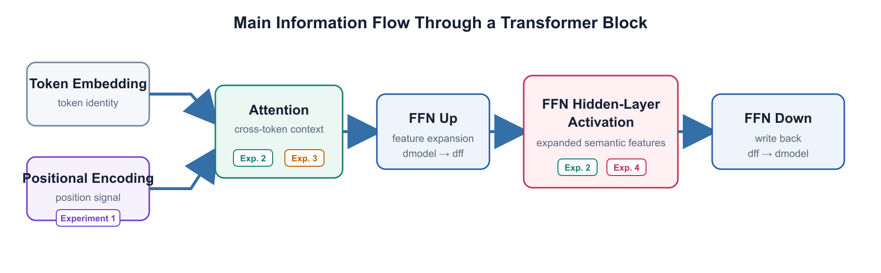
Structural intervention points in the Transformer
Semantic information is introduced, routed, expanded, and written back at these stages
Positional encoding and Attention determine contextual relations; FFN up-projection, activation, and down-projection determine how within-token features form and mix again.
COMP9992 · 05
Notes:
This diagram locates the interventions inside one Transformer block. Token embeddings and positional encoding establish the initial representation. Attention moves information across tokens. The FFN then expands each contextualised token, applies a nonlinearity, and writes the result back through the down-projection. Experiments 1 and 3 mainly change the positional and Attention path. Experiments 2 and 4 examine the relation between Attention and the FFN intermediate activation. I use this simplified flow throughout the talk so that each structural change can be tied to a specific part of the computation.

Slide 6
Literature review: two broad routes
Interpretability research broadly divides into post-hoc explanation and intrinsic design
Post-hoc interpretability
Intrinsic or by-design interpretability
Train the black-box model first
Introduce explicit structure during training
↓
↓
Probes, attribution, SAEs, Transcoders, and circuit tracing
Concept bottlenecks, codebooks, modular routing, and sparse units
Advantage: preserves the original model's capability
Risk: explanations are approximate and may not be the model's native computational units
Advantage: the explanatory interface participates in computation
Risk: it may damage capability or be bypassed by the model
This project follows the intrinsic route, while using post-hoc SAEs, semantic probes, and causal interventions to evaluate each structure.
COMP9992 · 06
Notes:
I found it useful to separate the literature into two routes. Post-hoc methods train the language model first and then analyse it with probes, attribution, SAEs, Transcoders, or circuit tracing. They preserve the original model, but the resulting explanation is still an approximation. Intrinsic methods place a concept, codebook, modular route, or sparse unit inside the trained computation. That makes the interface more direct, but it can reduce capability or be bypassed. My experiments follow the intrinsic route, while post-hoc and causal tools are used to evaluate the proposed structures.

Slide 7
Literature review: progress in post-hoc methods
Current methods can identify features and circuits, but still struggle to prove how the model originally computes
Can information be decoded?
Linear probes and TCAV
Test whether a representation contains particular information
What does a feature represent?
Automated neuron interpretation and SAEs
Generate descriptions and decompose dense activations
Does the feature causally matter?
Activation patching and causal tracing
Test output changes through replacement or intervention
How do features compose across layers?
Transcoders, Crosscoders, and Circuit Tracing
Extend single-layer features into cross-layer computational paths
Core limitations: feature splitting, absorption, cross-seed instability, and the fact that reconstruction does not prove the original model computes in those units.
COMP9992 · 07
Notes:
On the post-hoc side, the field can now recover information, describe features, test causal effects, and trace some cross-layer paths. Probes and concept directions test decodability. SAEs and automated interpretation provide candidate feature descriptions. Activation patching and causal tracing test whether those features affect the output. Transcoders extend the analysis across layers. The remaining difficulty is that reconstruction does not show that the original model used the reconstructed features as its own computational units. Feature splitting, absorption, and instability across seeds make that distinction important.

Slide 8
Literature review: progress in intrinsic structures
Research now spans concepts, discrete addresses, modular routing, and sparse interactions
Concept interface
Concept Bottleneck
Discrete representation
Codebook Features
Predict human concepts first, then use them to solve the task
Use sparse discrete codes to create clearer internal addresses
Modular routing
Interpretable MoE / sparse MoE
Attention decomposition
Lorsa
Assign different functions to separate modules or experts
Decompose interactions using many sparse one-dimensional Attention units
Position and context
RoPE / ALiBi / PoPE / CABLE / DIET
FFN sparsity
Sparsemax / Entmax / ProSparse / Spark
Change how content, position, and distance priors are combined
Reduce activation or routing, although the primary objective is often efficiency or capability
Existing structures often improve one local property, but lack a unified controlled evaluation across task, semantic, causal, and cost outcomes.
COMP9992 · 08
Notes:
Intrinsic approaches place the explanatory interface at different points in the model. Concept Bottleneck Models predict human concepts before the task output. Codebooks create discrete internal addresses. Modular and sparse routing divide computation across units or experts. Other work changes Attention or positional priors. These methods are not direct substitutes because they intervene at different stages. What is still often missing is a controlled evaluation that checks language performance, semantic quality, causal behaviour, and practical cost together.

Slide 9
Research gaps
Existing work still lacks four kinds of direct, unified, controlled evidence
Position decoupling → SAE
Can structural separation of content and position improve SAE decomposability and identity stability?
Structural sparsity → semantics
Can sparse Attention and FFNs jointly improve reconstruction, semantic boundaries, and causal locality?
Remote relevance → exemption
Does a monotonic distance penalty suppress important remote information, and can relevance gating relax it safely?
FFN concepts → communication
Do pre-down-projection concept slots need cross-token communication, and is it better than simple projection?
Shared gap: improvements in one metric are often treated as overall interpretability gains without parameter matching, cross-seed replication, and causal intervention.
COMP9992 · 09
Notes:
The review left four questions that could be tested directly. Does separating content and position improve later SAE representations? Does structural sparsity improve semantic and causal properties rather than only compression? Can a relevant distant key be exempted from a monotonic distance penalty without creating new failure modes? And do FFN-derived concept slots benefit from an additional cross-token communication mechanism? For each question, I use matched baselines, independent model seeds where available, and a separate causal or semantic check rather than relying on one proxy metric.

Slide 10
Research objective
Find the smallest structural interface that passes task, semantic, causal, and cost checks
Overall objective: induce internal representations that are easier to understand, decompose, and intervene on, while broadly preserving language-model capability and efficiency.
Experiment 1
Experiment 2
Experiment 3
Experiment 4
Position decoupling
Structural sparsity
RA-CABLE
Concept interface
Does PoPE improve SAE representations?
Does sparsity promote monosemanticity?
Does relevance improve remote information use?
Does a second concept Attention mechanism add value?
Strategy: start from a simple baseline, add one major structural variable at a time, and scale only after demonstrating an independent, reproducible benefit.
COMP9992 · 10
Notes:
These four questions became four experiments. The first starts with positional encoding. The second changes sparse routing in Attention and the FFN. The third develops a relevance-aware version of CABLE. The fourth projects fixed-identity concept slots from the FFN intermediate activation and compares a simple projector with an additional concept Attention mechanism. The common rule is to add one main structural variable at a time. A more complicated mechanism is only useful if it produces a benefit that the simpler matched baseline does not already provide.

Slide 11
Experiment 1: objective and theoretical basis
Can explicitly separating ‘what’ from ‘where’ improve SAE representations?
Objective: test whether the way position and content are combined in Attention affects the decomposability of later residual representations.
RoPE
PoPE
Content phase and relative position appear in the same cosine term, so ‘what’ and ‘where’ jointly determine the Attention score.
Content is retained only in the magnitude, while direction is set by positional phase and per-head biases, explicitly separating ‘what’ from ‘where’.
Core hypothesis: if RoPE's content–position coupling is a major source of feature mixing, PoPE should improve SAE reconstruction, cross-seed stability, and token-identity preservation.
COMP9992 · 11
Notes:
I started with the relation between content and position. In RoPE, content phase and relative position contribute to the same trigonometric score. PoPE changes that relation so that content is retained in the magnitude while positional phase and head-specific offsets control direction. My hypothesis was that, if this coupling was an important source of feature mixing, PoPE would improve SAE reconstruction, cross-seed stability, and token-identity preservation. The experiment therefore tests not only whether the diagnostic correlation falls, but whether any downstream representation benefit appears.

Slide 12
Experiment 1: design and evaluation
Five positional mechanisms are compared at both model and SAE levels under the same training budget
Model
Data
Training
SAE
12 layers, 12 heads, d_model=768, d_ff=3072
OpenWebText; sequence length 1024
30,000 steps; model seeds 41/42/43
Blocks 2/6/10; Top-K; multiple SAE seeds
Task performance
Structural effect
SAE reconstruction
Validation loss and perplexity
Content–position correlation and Attention-distance patterns
Explained variance and loss recovery
Semantic stability
Identity preservation
Fairness
Cross-seed matching and activation correlation
Same-token versus different-token activation difference
Matched data, steps, and token budget
Success is not the lowest correlation; decoupling must also improve model performance, SAE reconstruction, and semantic stability.
COMP9992 · 12
Notes:
I compared five positional mechanisms under the same model scale, OpenWebText data, sequence length, training steps, and token budget. Three model seeds were trained, and SAEs were fitted at blocks 2, 6, and 10. I evaluated model loss and perplexity, content–position relationships, Attention-distance patterns, SAE reconstruction, cross-seed matching, and token-identity preservation. The success condition was deliberately strict: a lower content–position correlation would count only if it was accompanied by a language-model, reconstruction, or semantic-stability benefit.

Slide 13
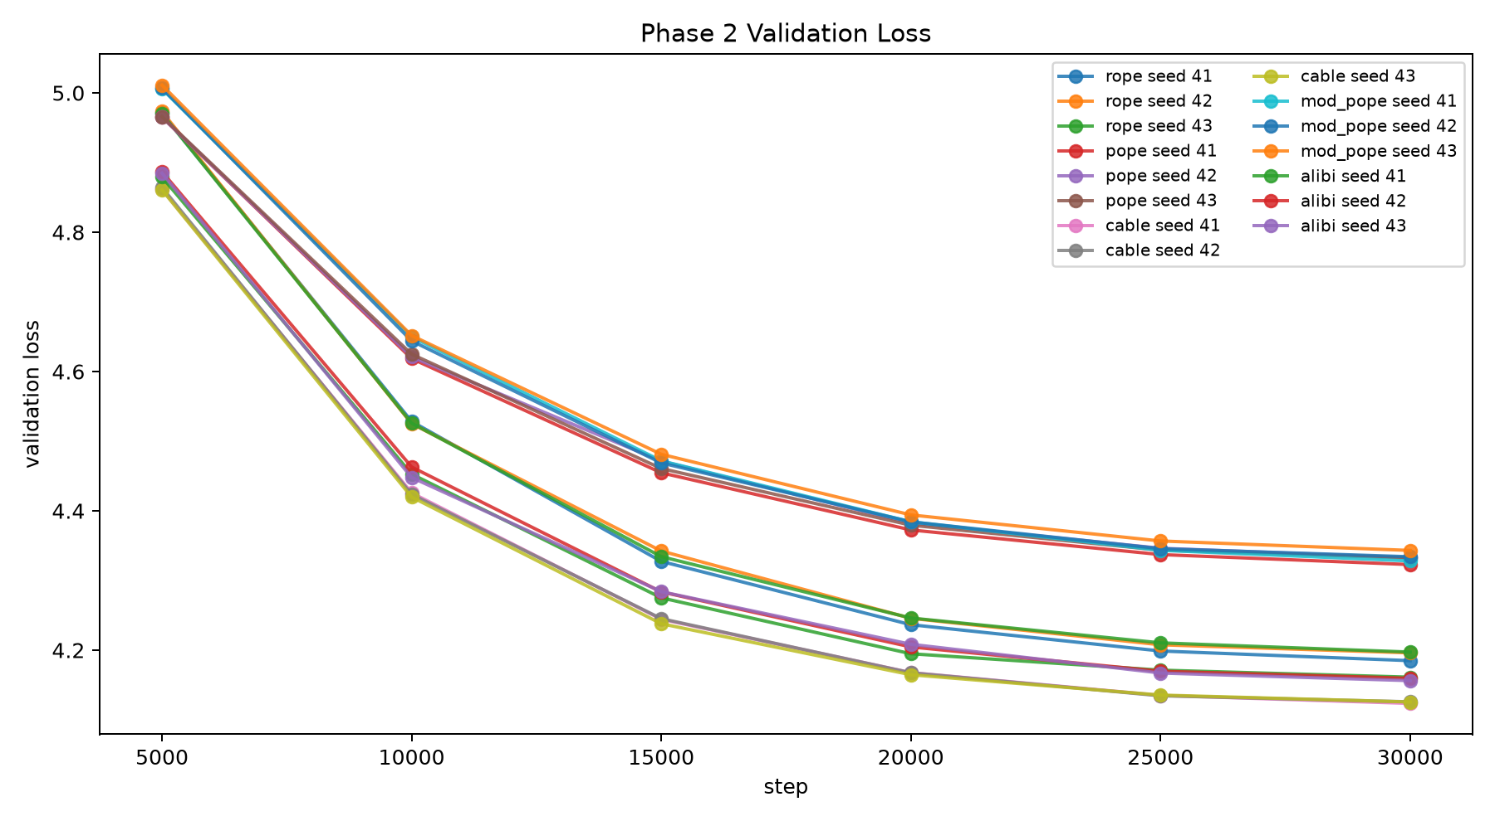
Experiment 1: results and conclusion
PoPE reduced content–position coupling, but did not improve model performance or SAE representations
0.0773
PoPE content–position score correlation
RoPE: 0.1035
75.90
PoPE perplexity
RoPE: 66.20; lower is better
0.7086
PoPE SAE explained variance
RoPE: 0.7409; higher is better
Conclusion: information separated during encoding may mix again later; positional encoding is an indirect interpretability lever.
COMP9992 · 13
Notes:
The result was clear. PoPE produced the lowest measured content–position score correlation, so the structural change did affect the diagnostic. However, its perplexity was worse than RoPE, and its SAE explained variance was also lower. In other words, the local separation did not survive as a useful downstream benefit. My interpretation is that position and content can mix again through later Attention, residual, and FFN computation. This makes positional encoding an indirect interpretability lever rather than a reliable intervention point on its own.

Slide 14
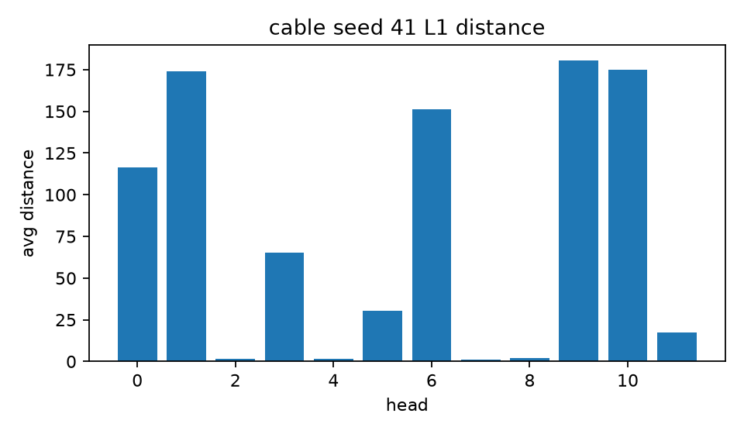
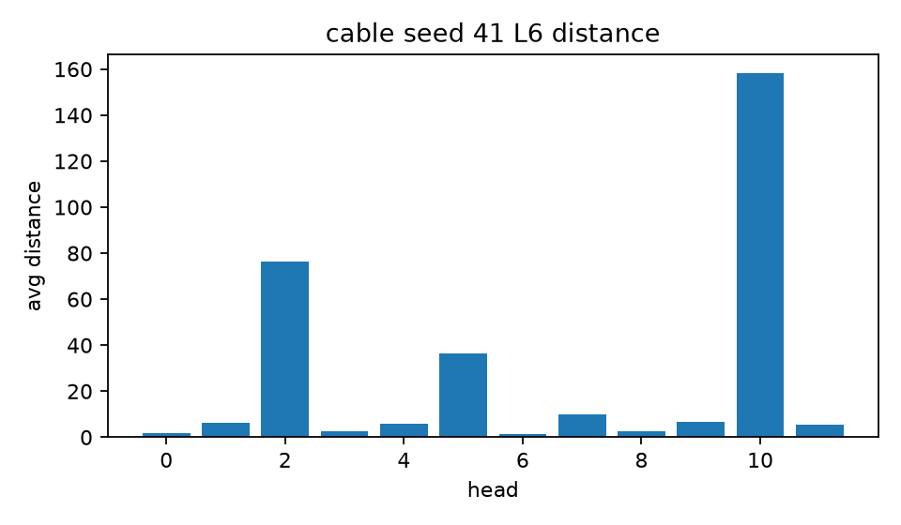
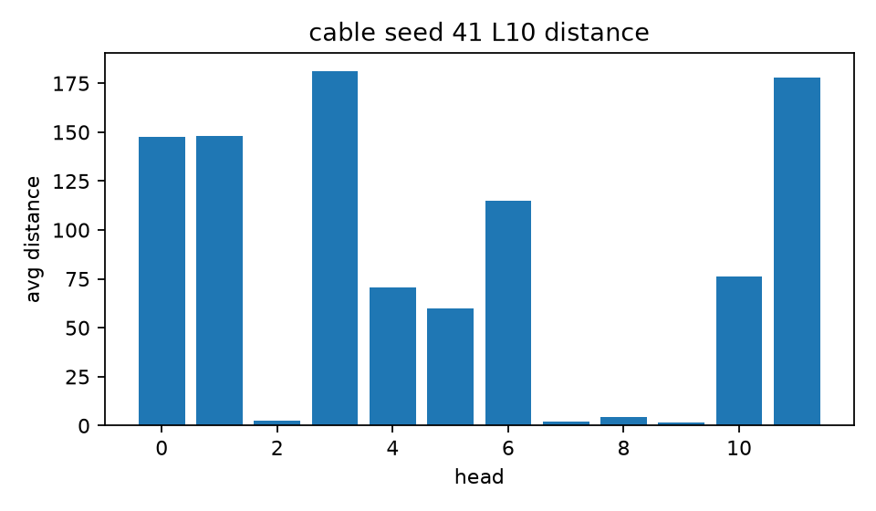
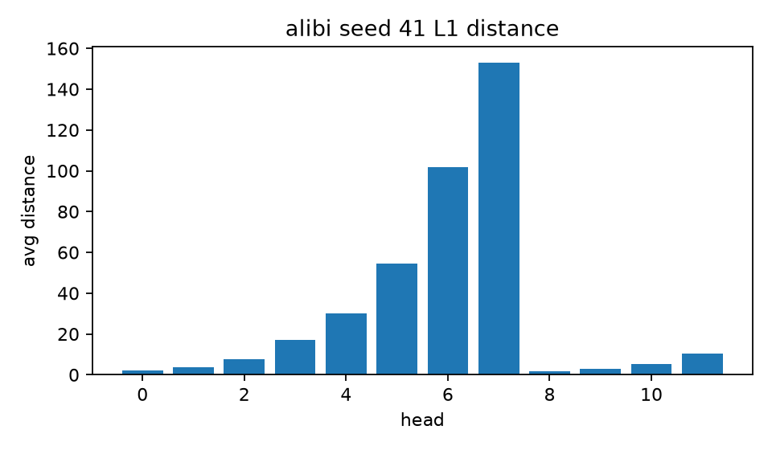
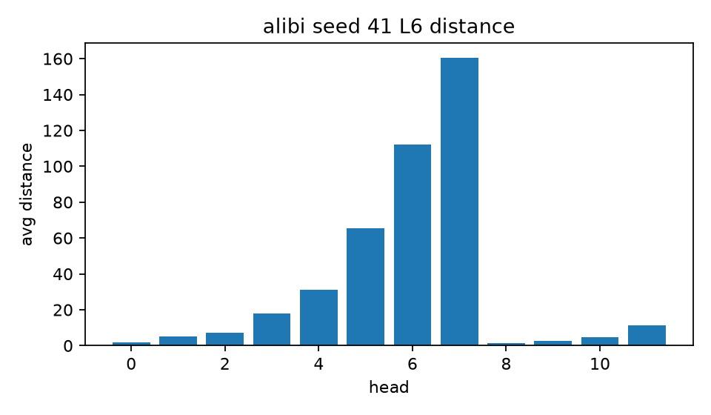
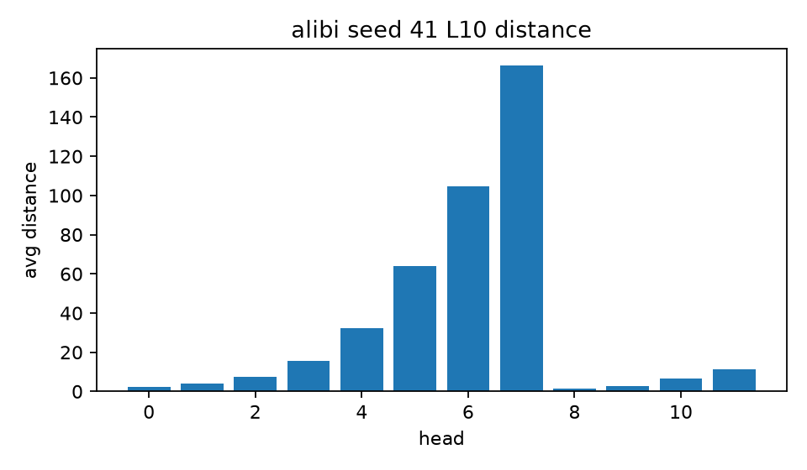
Experiment 1: further finding
ALiBi fixes head-distance ratios, whereas CABLE allows distance roles to reorganise across layers
Layer 1
Layer 6
Layer 10
CABLE
Consistency 0.0032
ALiBi
Consistency 0.9900
Each panel has an independent y-scale: compare head ordering and cross-layer stability, not absolute bar height.
COMP9992 · 14
Notes:
While comparing the positional mechanisms, I found a useful difference between ALiBi and CABLE. ALiBi fixes the relative slopes assigned to its heads, so the ordering of local and long-range heads stays almost unchanged across layers. CABLE allows those distance roles to reorganise with context and depth. Each panel uses its own vertical scale, so the point is the head ordering and cross-layer consistency, not the absolute bar height. This does not establish interpretability, but it motivated the next question about adaptive distance priors and remote information.

Slide 15
Experiment 1: limitations and next steps
Positional encoding acts indirectly; the next step is to trace how information mixes again
Current limitations
Next steps
Mechanism not traced
The experiment observes final model and SAE metrics, but does not trace when content and position mix again across layers.
Trace later mixing
Measure content and positional information layer by layer through Attention, the FFN, and the residual stream.
Limited scale and context
Three model seeds, length 1024, and a small GPT cannot represent longer contexts or larger models.
Broaden replication
Increase model seeds, context length, and model scale to test whether the conclusion holds.
Proxy coverage
Content–position correlation covers only part of SAE semantics and cannot directly represent overall interpretability.
Adaptive distance priors
Continue studying ALiBi/CABLE-style distance priors, while linking task gains to Attention audits.
This experiment narrows the search space: separating ‘what’ and ‘where’ only at encoding is insufficient to improve later representations directly.
Page 15
COMP9992 · 15
Notes:
This experiment also set a boundary on the conclusion. I measured final model and SAE outcomes, but I did not trace the exact layer at which content and position mixed again. The model is relatively small, the context length is 1024, and there are three model seeds. The correlation measure also covers only one part of semantic structure. The next step is therefore to trace position and content through Attention, the FFN, and the residual stream, and then repeat the comparison at longer context lengths and larger scales.

Slide 16
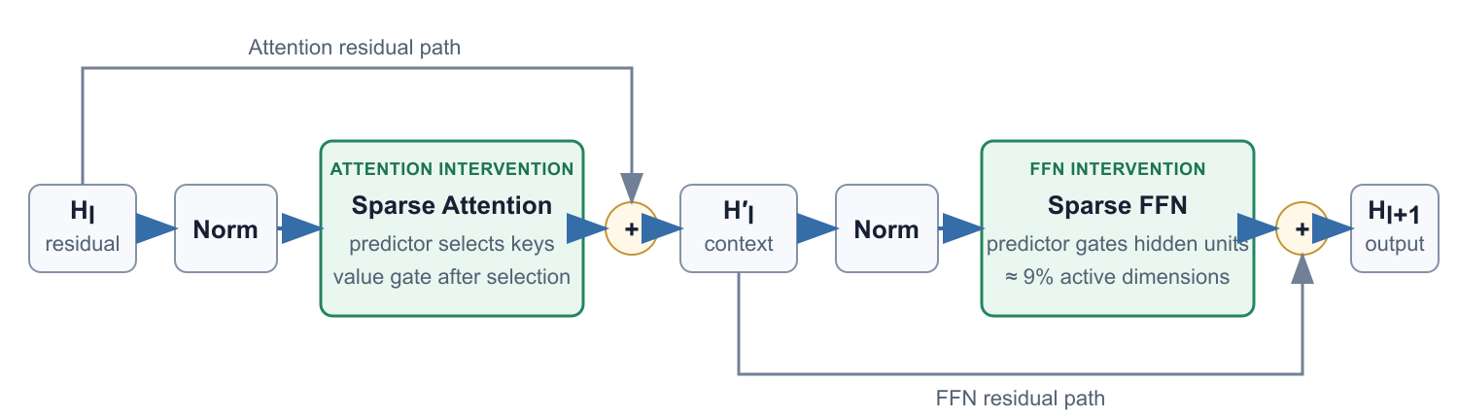
Experiment 2: objective and theoretical basis
Can using fewer features per computation reduce superposition and promote monosemanticity?
Aim
Sparsify both cross-token routing and within-token FFN activation
Theory
Fewer active units may reduce feature superposition and make SAE decomposition easier
Risk
Top-K sparsity may restrict model capacity and introduce sorting cost
COMP9992 · 16
Notes:
The second experiment moves from position to structural sparsity. The working hypothesis is that fewer active routes and FFN units may reduce superposition and make features easier for an SAE to separate. I sparsify both cross-token routing and within-token FFN activation. Top-K selection creates an immediate risk, however: it can restrict capacity and introduce an expensive ranking step. For that reason, activation density is not treated as the final result. Compression, semantic quality, causal locality, language performance, and runtime are evaluated separately.

Slide 17
Experiment 2: design and evaluation
A 3×2 design separates structural, semantic, causal, and cost effects
Base
Standard Attention + dense FFN
SP
Predictor/value split + Top-K FFN
Fast-SP
Window approximation that reduces full-ranking cost
Each structure is paired with RoPE and CABLE; model seeds 41/42/43 produce 18 language models and 90 SAEs.
Structure
FFN activation density
Fidelity
SAE NMSE and loss recovery
Semantics
AUPRC, hard negatives, and context consistency
Causality
Necessity, sufficiency, and local side effects
Task
Validation cross-entropy
Cost
Training time and throughput
The primary result fixes SAE k=64 in advance; three independent model seeds are the statistical units, with FDR correction.
COMP9992 · 17
Notes:
For this experiment I used a three-by-two design. Base, SP, and fast-SP were each paired with RoPE and CABLE. Seeds 41, 42, and 43 produced 18 language models and 90 fitted SAEs. The primary SAE setting fixes k at 64. I report FFN activation density, SAE NMSE and loss recovery, concept AUPRC and hard negatives, causal necessity and sufficiency, validation cross-entropy, training time, and throughput. The statistical unit is the independently trained language-model seed, with FDR correction for multiple comparisons.

Slide 18
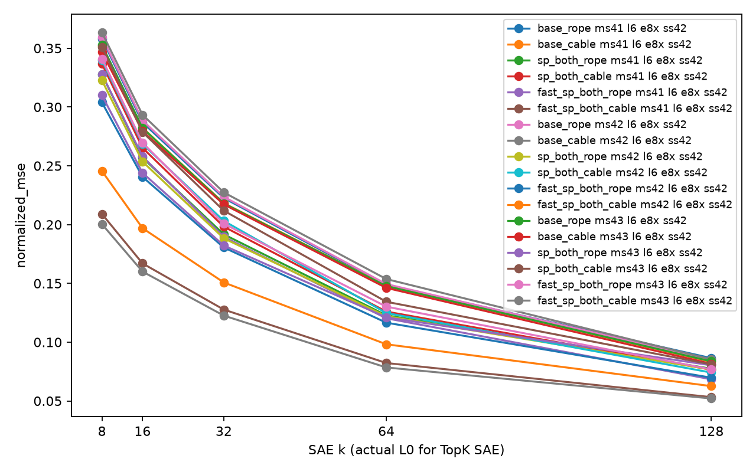
Experiment 2: results and conclusion
Sparsity improved compressibility without jointly improving semantics or causal locality
9.17%
SP-RoPE FFN activation density
Base-RoPE: 100%
−17.89%
SAE NMSE relative to Base-RoPE
0.1220 versus 0.1485
+232%
SP-RoPE training time
19,161 s versus 5,771 s
Conclusion: sparsity, SAE reconstruction, monosemanticity, causal locality, and actual acceleration must be evaluated separately.
COMP9992 · 18
Notes:
SP did make the activation much sparser, and SAE NMSE improved relative to Base-RoPE. Under this SAE setting, the representation was easier to compress. The semantic and causal measures did not improve consistently, and the training time rose from 5,771 seconds to 19,161 seconds. The implementation still performs dense projections and ranking operations, so a lower non-zero rate did not become a speedup. I therefore separate five claims that are often conflated: sparsity, reconstruction, monosemanticity, causal locality, and acceleration.

Slide 19
Experiment 2: limitations and next steps
The sparse structure works, but semantic objectives and actual acceleration remain unresolved
Current limitations
Next steps
SAE seed variance
The primary analysis has three model seeds but only one SAE seed per model, so SAE-training variability is not estimated.
More model and SAE seeds
Increase both model and SAE seeds to estimate the two sources of randomness separately.
Dense computation remains
Original SP still performs dense projections and full statistics; fewer non-zeros do not automatically become actual speedup.
Avoid full ranking
Study learnable thresholds, low-cost block predictors, and sparse kernels that truly skip inactive units.
Indirect objective
The current sparsity constraint controls activation count but does not directly optimise semantic boundaries, deduplication, or causal locality.
Direct interpretability loss
Train with hard negatives, feature deduplication, and local causal constraints, then ablate each component.
The next step is not simply to reduce non-zero rate, but to test whether sparsity yields reproducible semantic, causal, and runtime benefits.
Page 19
COMP9992 · 19
Notes:
There are three reasons not to overstate this result. First, each language model currently has only one SAE seed, so SAE-training variability is not estimated. Second, the sparse activations do not skip the dense matrix computation. Third, the training objective controls the number of active units rather than their semantic boundaries or causal side effects. A stronger follow-up would add both model and SAE seeds, replace global ranking with learnable thresholds or block predictors, use kernels that genuinely skip inactive units, and train against direct semantic and causal objectives.

Slide 20
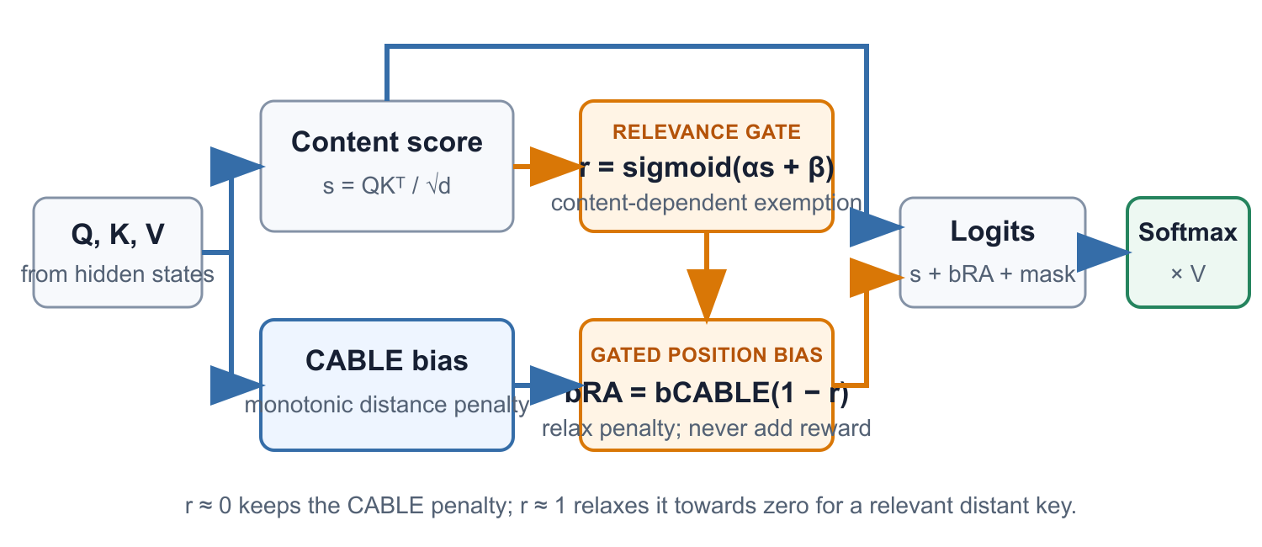
Experiment 3: objective and theoretical basis
RA-CABLE relaxes positional penalties only for semantically relevant distant keys
r near 0: preserve the CABLE penalty
r near 1: reduce the penalty towards zero, without adding a positive reward
Problem
Important distant information must still overcome a larger monotonic positional penalty
Aim
Use query–key relevance to generate a constrained exemption gate
Risk
Amplifying spurious relevance, frequent-token exemptions, and Attention sinks
Non-monotonicity is not the goal; success requires joint gains in long-range tasks, semantic exemptions, and cost.
COMP9992 · 20
Notes:
The ALiBi and CABLE comparison led to the third experiment. CABLE makes distance increments context-dependent, but the accumulated positional penalty remains monotonic. A distant key can still win through its content score, although it must overcome a larger penalty. RA-CABLE adds a relevance gate derived from the actual query–key score. When the gate is near zero, the CABLE penalty remains. When it approaches one, the penalty is relaxed towards zero; the positional mechanism never gives a positive reward. The central question is whether that exemption helps relevant remote information without creating false exemptions or Attention sinks.

Slide 21
Experiment 3: design, evaluation, and current status
Results are still running; success criteria were fixed in advance
Comparisons
Training scale
Lengths and tasks
RoPE, ALiBi, CABLE, and RA-CABLE
GPT-2 Small scale; 1B tokens per model; 8 planned seeds
1024/2048/4096/8192; natural text, QASPER, and remote retrieval
Long-range use
Retrieval accuracy and Relevant Attention Advantage
Exemption semantics
Higher SESR while controlling FER and Attention sinks
Short-context protection
At length 1024, PPL degrades by no more than 1% relative to CABLE
Real-world task
QASPER F1/EM and evidence-use gains
Engineering cost
Training, inference, throughput, and peak memory
Causal link
Changes in distance patterns must correlate with task gains
Experiment still running
Results will be added after the full cross-seed evaluation.
COMP9992 · 21
Notes:
These runs are not yet complete, so I am only presenting the design and the success criteria here. The planned comparison covers RoPE, ALiBi, CABLE, and RA-CABLE at GPT-2 Small scale, with one billion tokens per model and eight seeds. Evaluation lengths range from 1024 to 8192 and include natural text, QASPER, and controlled remote retrieval with nearby distractors. RA-CABLE must beat Base-CABLE on retrieval and relevant Attention advantage while controlling false exemptions, sinks, short-context perplexity, runtime, and memory.

Slide 22
Experiment 3: limitations and next steps
The experiment is incomplete; the priority is a full evidence chain under the preregistered criteria
Current limitations
Next steps
Results are incomplete
Training, long-context evaluation, Attention audits, and cross-seed summaries are not all complete.
Complete all four evaluations
Complete length 1024–8192, controlled retrieval, QASPER, and natural-text evaluations.
The gate may amplify errors
Query–key relevance may itself contain spurious correlations, frequent-token bias, or Attention sinks.
Complete the exemption audit
Report correct exemptions, false exemptions, sinks, remote advantage, and distance patterns together.
Cost is not yet established
A full Attention gate adds elementwise computation and memory; its actual overhead must be measured separately.
Maintain fair comparisons
Prioritise RA-CABLE versus Base-CABLE, while retaining Base-RoPE as a reference and reporting cost.
RA-CABLE is supported only if long-range tasks, semantic exemptions, short-context protection, and cost improve together.
Page 22
COMP9992 · 22
Notes:
Because the experiment is unfinished, the next step is evidence collection rather than interpretation. The relevance gate may amplify spurious query–key correlations, frequent-token bias, or an existing Attention sink. Applying a gate to the full Attention matrix may also add elementwise computation and memory. I will therefore report correct and false exemptions together, not only average distance. The main comparison is RA-CABLE against Base-CABLE under matched initialisation and training, with Base-RoPE retained as a reference. The hypothesis is supported only if task, semantic, short-context, and cost criteria improve together.

Slide 23
Experiment 4: deriving the hypothesis
A higher-level concept interface must satisfy two conditions
Condition 1: higher-level concepts depend on context
Condition 2: concepts need a more suitable representation space
A shared low-dimensional space that accumulates Attention and FFN outputs across layers, allowing features to mix repeatedly.
‘Bread’ does not have a fixed France attribute
residual stream
Only when context establishes relations such as ‘this bread comes from France’ does COUNTRY = France become part of the current meaning.
FFN activation U
Expansion and nonlinear activation create a wider candidate space from which fixed concept slots can be projected.
Implication: a concept representation must aggregate cross-token context
Implication: concept slots should be projected from full U before down-projection
↓
↓
Together, the two conditions imply the experimental structure
Project fixed-identity concept slots from the full FFN activation U, then apply controlled cross-token Attention before down-projection.
COMP9992 · 23
Notes:
The fourth experiment started from a question about where a higher-level concept could be represented. A token such as bread does not have a fixed France attribute. COUNTRY equals France becomes relevant only after the surrounding tokens establish that relation. The representation must therefore include context. At the same time, the FFN intermediate activation U is wider than the residual stream and sits after nonlinear expansion but before down-projection. I use U as the candidate space from which fixed-identity concept slots are projected, then test whether those slots need controlled cross-token communication before write-back.

Slide 24
Experiment 4: objective and theoretical basis
Higher-level concepts need both fixed identities and context
01
Contextualised residual
02
FFN activation U
03
Fixed concept slots
→
→
Attention has already aggregated token context
COUNTRY
COLOR
‘France’ is not a fixed attribute of every token. Location, relation, and modifying context determine which entity belongs to France.
‘Red’ becomes COLOR = Red for the task only after it is bound to the correct entity.
Objective: project fixed-identity concept slots from the full FFN activation and test whether cross-token communication before down-projection provides an independent benefit.
COMP9992 · 24
Notes:
Traditional Attention has already contextualised each token in the residual stream. The FFN then expands that contextualised representation into U before compressing it back through the down-projection. I project two fixed slots, COUNTRY and COLOR, from the complete U. France is useful only when it is attached to the correct entity, and Red is useful only when it is bound to the correct object. This gives a concrete interface that can be read, zeroed, and swapped, while keeping the projection point tied to a specific stage of the model's computation.

Slide 25
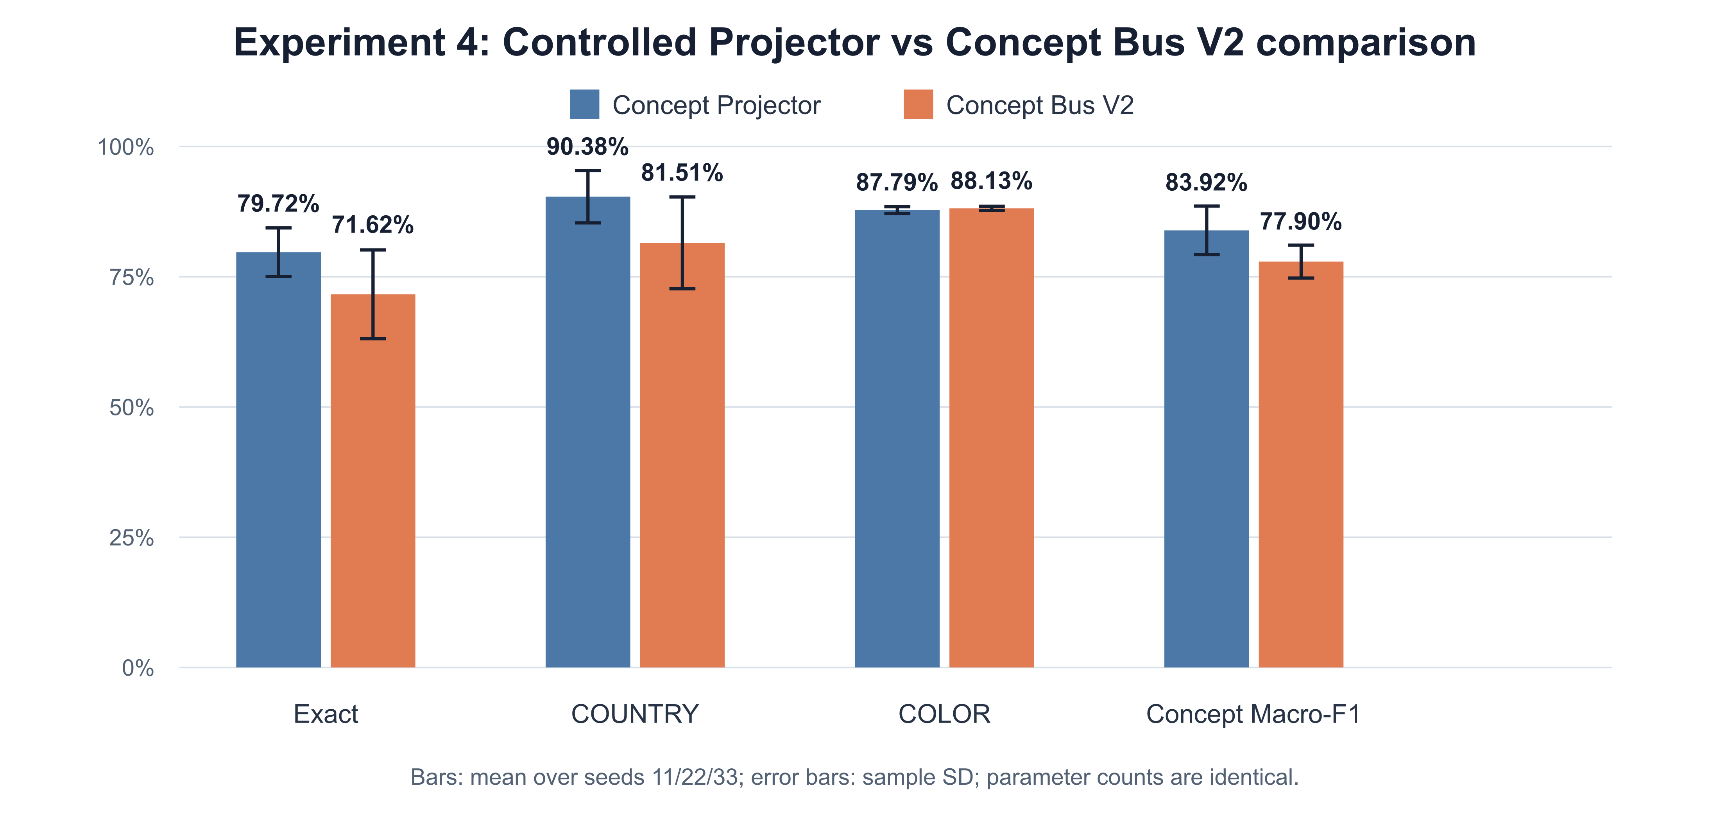
Experiment 4: method and fair controls
Projector and Bus V2 differ primarily in whether they use cross-token communication
Standard
Standard Transformer without an explicit concept interface
Task baseline
Concept Projector
Project COUNTRY/COLOR from full U and process only the current token
Minimal strong baseline
Concept Bus V2
Use the same projection, then add per-slot causal Attention
Added variable: cross-token communication
COMP9992 · 25
Notes:
I used three matched variants to isolate the value of extra communication. Standard is an ordinary Transformer. Concept Projector produces 64-dimensional COUNTRY and COLOR slots from U and processes only the current token. Concept Bus V2 uses the same projections, slot widths, readouts, write-back, and training objectives, but adds per-slot causal Attention over current and previous tokens. Projector and V2 have the same parameter count. The main independent variable is therefore the cross-token communication added before the FFN down-projection.

Slide 26
Experiment 4: design and evaluation
Readability, necessity, interchangeability, locality, and low cost must hold together
Experimental setup
Success criteria
Data
Controlled COUNTRY × COLOR combinations and evidence relations
Task
No degradation in Exact, COUNTRY, or COLOR
Model
Standard, Projector, and Bus V2; seeds 11/22/33
Readable
Concept Macro-F1 and fixed identity
Fairness
Projector and V2 match in parameters, projections, and objectives
Causality
Zeroing demonstrates necessity; swaps succeed with low side effects
Statistics
Paired exact randomisation test with Holm correction
Cost
Acceptable parameters, MACs, runtime, throughput, and memory
A second Attention mechanism provides a net benefit only if it improves task performance, concept quality, and causal locality relative to Projector.
COMP9992 · 26
Notes:
DualTag lets me control COUNTRY, COLOR, and the evidence relation between them. Standard, Projector, and Bus V2 were trained with seeds 11, 22, and 33. Projector and V2 match in parameters, projections, and objectives. I evaluate Exact, COUNTRY, and COLOR accuracy; concept Macro-F1 and slot identity; causal necessity through zeroing; counterfactual swap success and side effects; and parameter, MAC, runtime, throughput, and memory cost. V2 is useful only if it improves the task, concept quality, or causal locality over the simpler Projector.

Slide 27
Experiment 4: task and concept results
The simple Projector outperforms Bus V2 with a second Attention mechanism
Mean accuracy across three model seeds (%)
−8.097 pp
100
Bus V2 − Projector
Exact
86.2
90.4
87.8
88.1
80.2
79.7
81.5
80
71.6
68.5
−8.873 pp
60
Bus V2 − Projector
COUNTRY
40
−6.011 pp
20
Bus V2 − Projector
concept Macro-F1
0
Standard
Projector
Bus V2
Exact
COUNTRY
COLOR
All three paired seeds show the same direction, but exact tests have limited power at n = 3; none are significant after Holm correction.
COMP9992 · 27
Notes:
The simplest model won this comparison. Mean Exact accuracy increased from 68.525 percent for Standard to 79.720 percent for Projector, while Bus V2 reached 71.623 percent. Relative to the matched Projector, V2 lost 8.097 percentage points on Exact, 8.873 on COUNTRY, and 6.011 on concept Macro-F1. COLOR changed very little. All three paired seeds moved in the same direction, although n equals three gives the exact tests low power, and none of the comparisons remains significant after Holm correction.

Slide 28
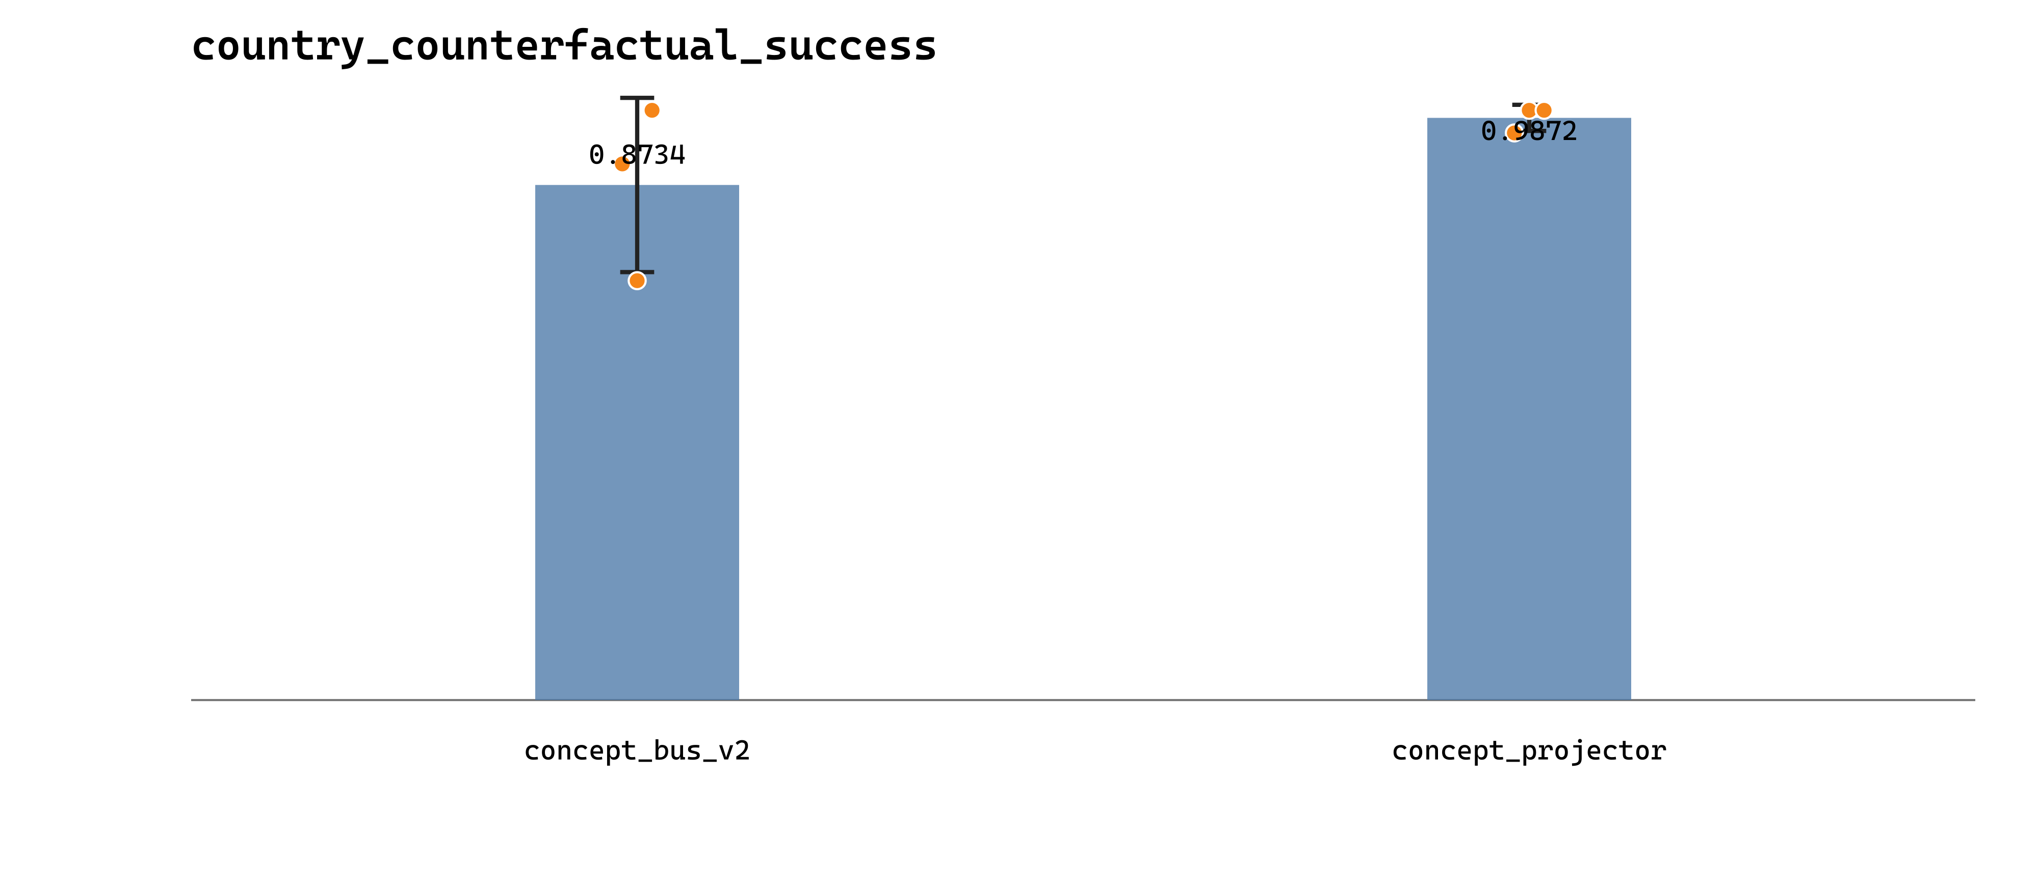
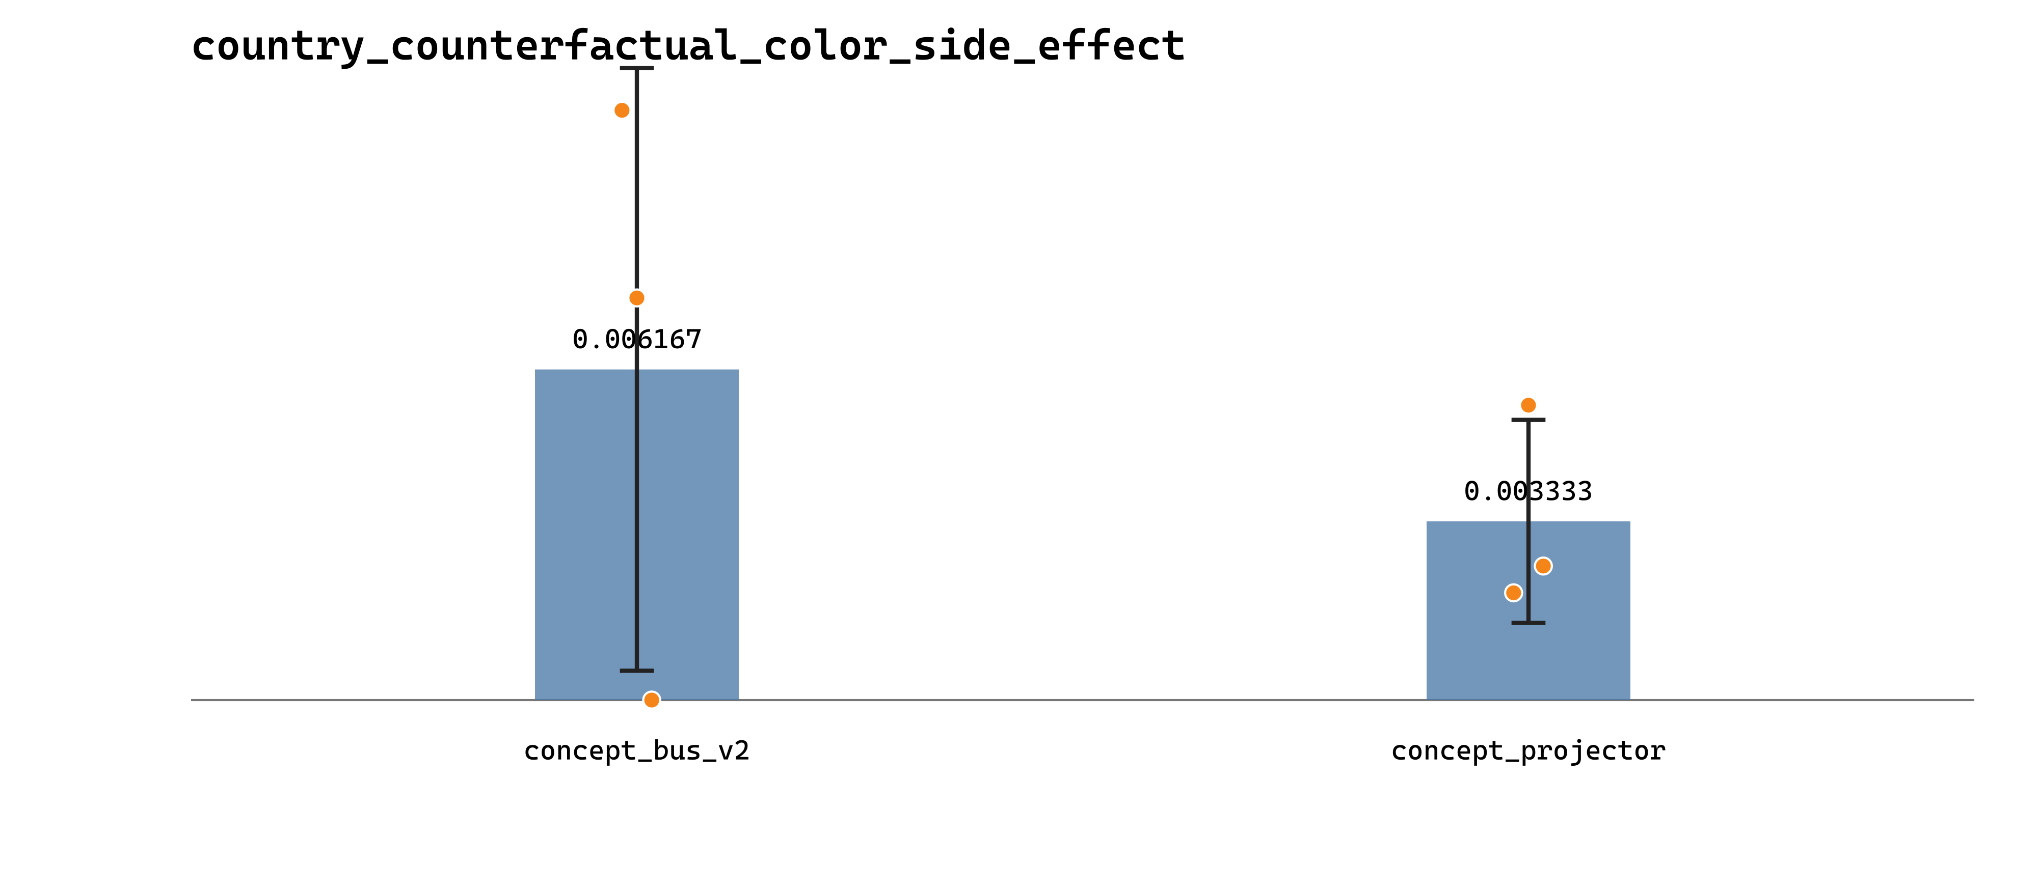
Experiment 4: causal results and conclusion
Concept slots can be zeroed and swapped, but extra communication does not improve necessity or locality
COUNTRY swap success rate
Side effect on COLOR after swapping COUNTRY
98.721%
0.333%
12.900 pp
Projector COUNTRY swap success
V2: 87.340%
Projector non-target COLOR changes
V2: 0.617%; lower is better
Exact drop after zeroing the full Projector bus
V2: 9.317 pp
COMP9992 · 28
Notes:
The causal tests point in the same direction. Zeroing the complete concept interface reduced Exact accuracy by 12.900 points for Projector and 9.317 for V2, which shows stronger reliance on the Projector interface. COUNTRY swap success was 98.721 percent for Projector and 87.340 percent for V2. The non-target effect on COLOR was also smaller for Projector. The fixed slots therefore formed a readable, zeroable, and swappable interface, but the additional cross-token Attention did not improve necessity or locality in this configuration.

Slide 29
Experiment 4: limitations and next steps
Projector forms a controllable interface, but the scope of generalisation remains limited
Current limitations
Next steps
The task is highly controlled
DualTag enables precise causal audits, but may overestimate how clear concept boundaries are in real text.
Extend Projector first
Use simple projection as a strong baseline and replicate on real text and additional model scales.
Two concepts only
Only fixed COUNTRY and COLOR slots are tested; more concepts and explicit hierarchical composition remain unverified.
Audit leakage and hierarchy
Increase concept count and audit parent–child composition, coverage, and non-target side effects.
Limited generalisation
Tests with three model seeds have limited power, and the results cannot be directly generalised to larger models or open-domain corpora.
Ablate bus complexity
Ablate communication range, slot width, and write-back separately; retain only components with independent benefits.
The most reliable direction is to establish a strong, simple concept projector first, then prove the necessity of each added communication mechanism.
Page 29
Questions and discussion
COMP9992 · 29
Notes:
I see the Projector result as the more useful outcome of Experiment 4. The present evidence comes from a controlled two-concept task and three model seeds, so it does not yet establish behaviour on open text or larger models. My next step would be to keep the simple Projector as the baseline, add more concepts and real-text evaluations, and test leakage, coverage, identity stability, and hierarchical composition. If the concept bus is revisited, communication range, slot width, and write-back should be added one at a time. Thank you, and I welcome your questions.

